Slide 1
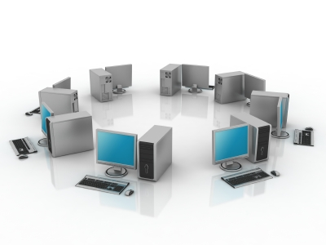
Organizations, Management, and the Networked Enterprise
Chapter 3
Information Systems, Organizations, and Strategy
MFIS
Lisa Murphy
Notes:
1

Slide 2
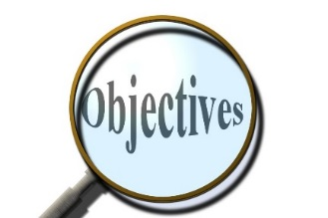
Learning Objectives
To gain an understanding of the following:
Identify and describe important features of organizations that managers need to know about in order to build and use information systems successfully
Demonstrate how Porter’s competitive forces model helps companies develop competitive strategies using information systems
Explain how the value chain and value web models help businesses identify opportunities for strategic information system applications
Demonstrate how information systems help businesses use synergies, core competencies, and network-based strategies to achieve competitive advantage
Assess the challenges posed by strategic information systems and management solutions

Slide 3

eBay Fine-Tunes Its Strategy
Problem:
Losing market share to other online retailers, ultra-competitive and constantly changing marketplace
Solutions:
Acquire other businesses and adjust its business model to maintain online dominance
Purchase of PayPal, deal with Buy.com
Allowed eBay to grow and diversify its business
Demonstrates IT’s role in the development of eBay’s organization as it expands and makes acquisitions
Illustrates the challenges of maintaining a competitive advantage in a fast-moving, constantly-changing marketplace

Slide 4
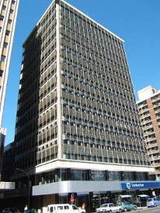
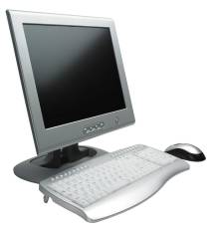
Organizations and Information Systems
Information technology and organizations influence one another
Complex relationship influenced by organization’s structure, business processes, politics, culture, environment, and management decisions

Slide 5
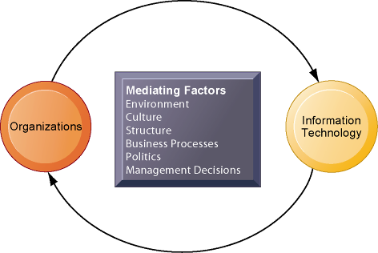
The Two-Way Relationship Between Organizations and Information Technology
This complex two-way relationship is mediated by many factors, not the least of which are the decisions made—or not made—by managers. Other factors mediating the relationship include the organizational culture, structure, politics, business processes, and environment.

Slide 6
What is an organization?
Technical definition:
Stable, formal social structure that takes resources from environment and processes them to produce outputs
A formal legal entity with internal rules and procedures, as well as a social structure
Behavioral definition:
A collection of rights, privileges, obligations, and responsibilities that is delicately balanced over a period of time through conflict and conflict resolution

Slide 7
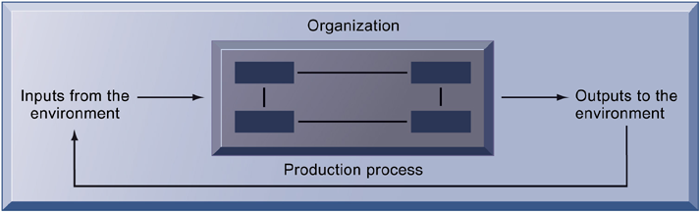
The Technical Microeconomic Definition of the Organization
In the microeconomic definition of organizations, capital and labor (the primary production factors provided by the environment) are transformed by the firm through the production process into products and services (outputs to the environment). The products and services are consumed by the environment, which supplies additional capital and labor as inputs in the feedback loop.

Slide 8
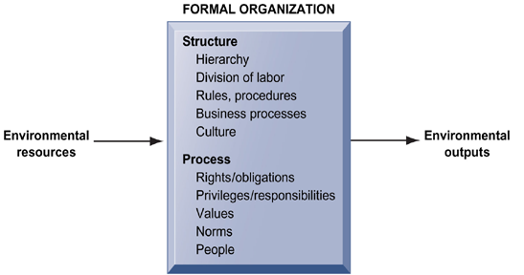
The Behavioral View of Organizations

Slide 9

Features of organizations
All modern organizations share some characteristics, such as:
Use of hierarchical structure
Accountability, authority in system of impartial decision making
Adherence to principle of efficiency
Other features include: Routines and business processes and organizational politics, culture, environments and structures

Slide 10
Routines and business processes
Routines (standard operating procedures - SOPs)
Precise rules, procedures, and practices developed to cope with virtually all expected situations
Business processes: Collections of routines
Business firm: Collection of business processes

Slide 11
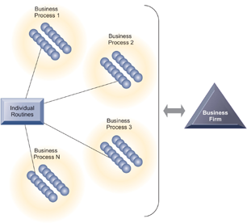
Routines, Business Processes, and Firms
All organizations are composed of individual routines and behaviors, a collection of which make up a business process.
A collection of business processes make up the business firm.
New information system applications require that individual routines and business processes change to achieve high levels of organizational performance.

Slide 12

Organizational politics
Divergent viewpoints lead to political struggle, competition, and conflict
Political resistance greatly hampers organizational change

Slide 13
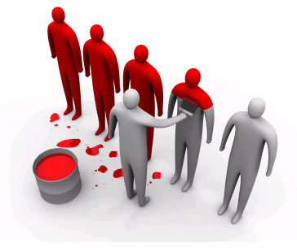
Organizational culture
Encompasses set of assumptions that define goal and product
What products the organization should produce
How and where it should be produced
For whom the products should be produced
May be powerful unifying force as well as restraint on change

Slide 14
Organizational environments
Organizations and environments have a reciprocal relationship
Organizations are open to, and dependent on, the social and physical environment
Organizations can influence their environments
Environments generally change faster than organizations
Information systems can be instrument of environmental scanning, act as a lens

Slide 15
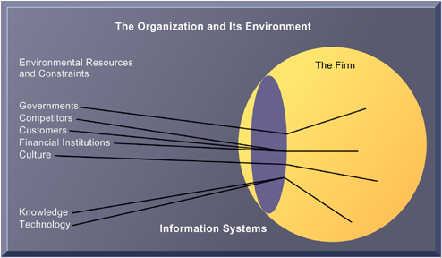
Environments and Organizations Have a Reciprocal Relationship
Environments shape what organizations can do, but organizations can influence their environments and decide to change environments altogether. Information technology plays a critical role in helping organizations perceive environmental change and in helping organizations act on their environment.

Slide 16
Disruptive technologies
Technology that brings about sweeping change to businesses, industries, markets
Examples: personal computers, word processing software, the Internet, the PageRank algorithm
First movers and fast followers
First movers – inventors of disruptive technologies
Fast followers – firms with the size and resources to capitalize on that technology

Slide 17
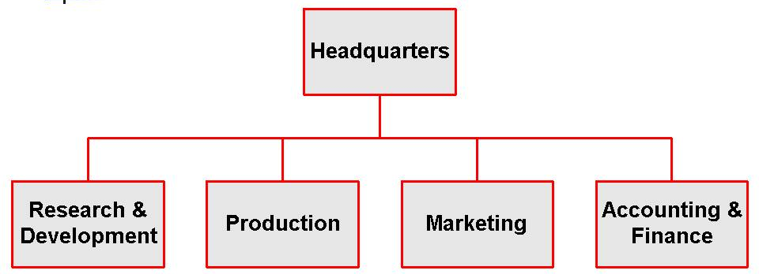
Organizational structures
Five basic kinds of structure
Entrepreneurial: Small start-up business
Machine bureaucracy: Midsize manufacturing firm
Divisionalized bureaucracy: Fortune 500 firms
Professional bureaucracy: Law firms, school systems, hospitals
Adhocracy: Consulting firms

Slide 18
Organizational structures

Slide 19
Other Organizational Features
Goals
Constituencies
Leadership styles
Tasks
Surrounding environments
Examples?

Slide 20
How Information Systems Impact Organizations and Business Firms
Economic impacts
IT changes relative costs of capital and the costs of information
Information systems technology is a factor of production, like capital and labor
IT affects the cost and quality of information and changes economics of information
Information technology helps firms contract in size because it can reduce transaction costs (the cost of participating in markets)
Outsourcing

Slide 21
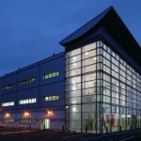
E xercise 1 – SOP
Creganna Medical Devices in Galway specialise in the manufacturing of Hypertubes that are used to aid people with cardiovascular diseases.
Write down 15 SOP’s, that the company would need to have in place.

Slide 22

Break Time
10 Minutes break!!

Slide 23
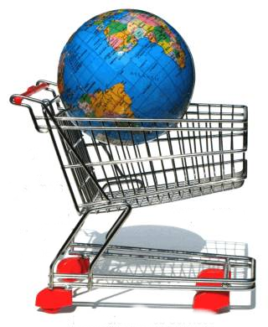
Transaction cost theory
Firms seek to economize on cost of participating in market (transaction costs)
IT lowers market transaction costs for firm, making it worthwhile for firms to transact with other firms rather than grow the number of employees

Slide 24
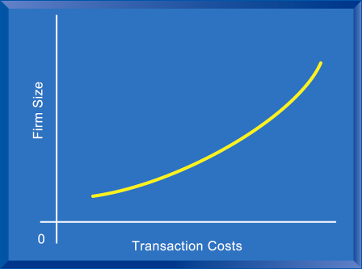
The Transaction Cost Theory of the Impact of Information Technology on the Organization
Firms traditionally grew in size to reduce transaction costs. IT potentially reduces transaction costs for a given size, opening up the possibility of revenue growth without increasing size, or even revenue growth accompanied by shrinking size.

Slide 25
Agency theory
Firm is nexus of contracts among self-interested parties requiring supervision
Firms experience agency costs (the cost of managing and supervising) which rise as firm grows
IT can reduce agency costs, making it possible for firms to grow without adding to the costs of supervising, and without adding employees

Slide 26
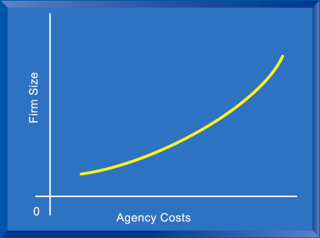
The Agency Cost Theory of the Impact of Information Technology on the Organization
As firms grow in size and complexity, traditionally they experience rising agency costs.

Slide 27
Organizational and behavioral impacts
IT flattens organizations
Decision making pushed to lower levels
Fewer managers needed (IT enables faster decision making and increases span of control)
Postindustrial organizations
Organizations flatten because in postindustrial societies, authority increasingly relies on knowledge and competence rather than formal positions

Slide 28
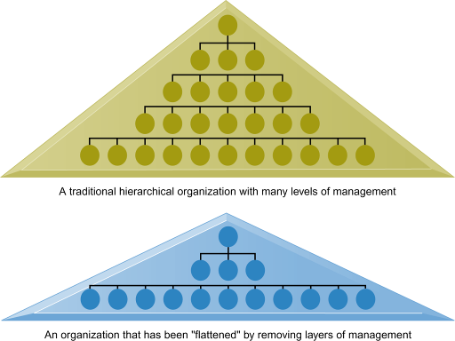
Flattening Organizations
Information systems can reduce the number of levels in an organization by providing managers with information to supervise larger numbers of workers and by giving lower-level employees more decision-making authority.

Slide 29
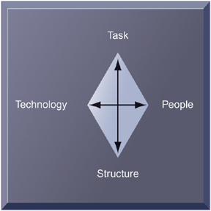
Organizational resistance to change
Information systems become bound up in organizational politics because they influence access to a key resource – information
Information systems potentially change an organization’s structure, culture, politics, and work
Most common reason for failure of large projects is due to organizational and political resistance to change

Slide 30

The Internet and organizations
The Internet increases the accessibility, storage, and distribution of information and knowledge for organizations
The Internet can greatly lower transaction and agency costs
Example: Large firm delivers internal manuals to employees via corporate Web site, saving millions of dollars in distribution costs

Slide 31
Planning a New System
Central organizational factors to consider when planning a new system:
Environment
Structure
Hierarchy, specialization, routines, business processes
Culture and politics
Type of organization and style of leadership
Main interest groups affected by system; attitudes of end users
Tasks, decisions, and business processes the system will assist

Slide 32
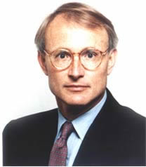
External environment: Porter five forces model
Provides general view of firm, its competitors, and environment
Five competitive forces shape fate of firm. The below assess the business and its external threats
1
2
3
4
5
Power of buyers
Power of suppliers
Extent of rivalry between existing competitors
Threat of new entrants
Threat of substitutes

Slide 33
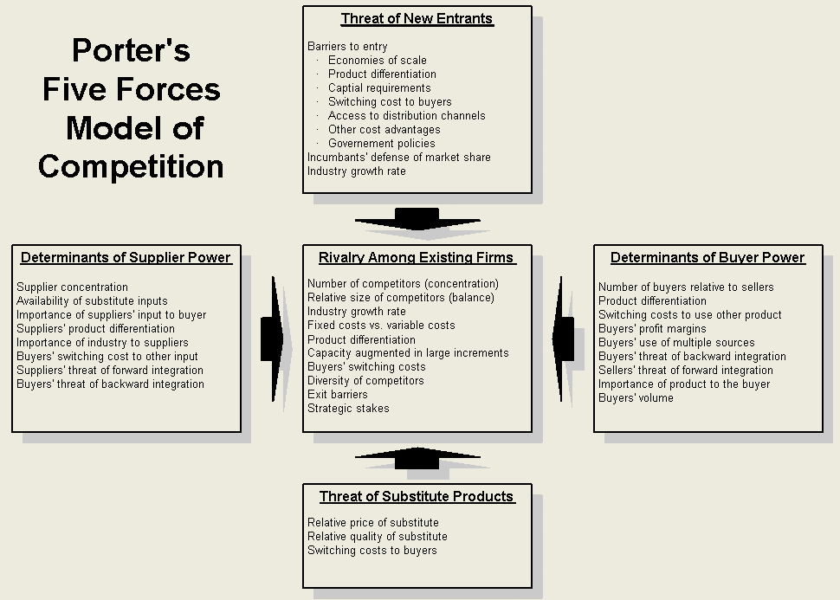
Hand-out

Slide 34
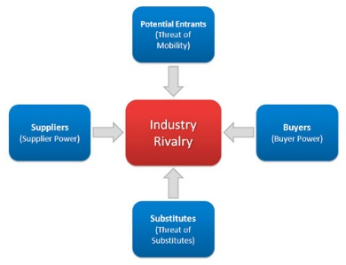
Porter’s Competitive Forces Model
Traditional competitors
All firms share market space with competitors who are continuously devising new products, services, efficiencies, switching costs
New market entrants
Some industries have high barriers to entry, e.g. computer chip business
New companies have new equipment, younger workers, but little brand recognition

Slide 35
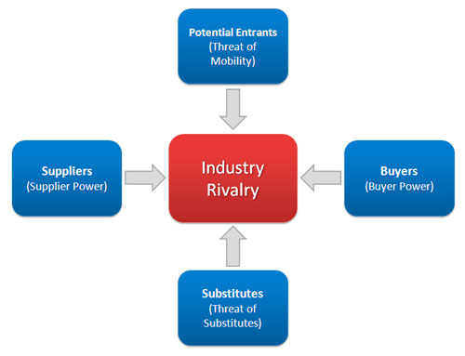
Porter’s Competitive Forces Model
Substitute products and services
Substitutes customers might use if your prices become too high, e.g. iTunes substitutes for CDs
Customers
Can customers easily switch to competitor’s products? Can they force businesses to compete on price alone in transparent marketplace?
Suppliers
Market power of suppliers when firm cannot raise prices as fast as suppliers

Slide 36
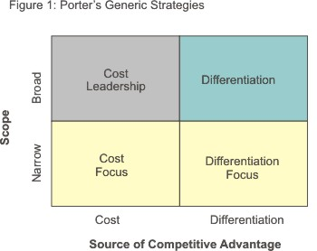
Strategies for dealing with competitive forces
Four generic strategies for dealing with competitive forces, enabled by using IT
Low-cost leadership
Product differentiation
Focus on market niche
Strengthen customer and supplier intimacy

Slide 37
Strategies for dealing with competitive forces
1. Low-cost leadership
Produce products and services at a lower price than competitors while enhancing quality and level of service
Examples: Wal-Mart, Dell
2. Product differentiation
Enable new products or services, greatly change customer convenience and experience
Examples: Google, Land’s End, Apple iPhone

Slide 38
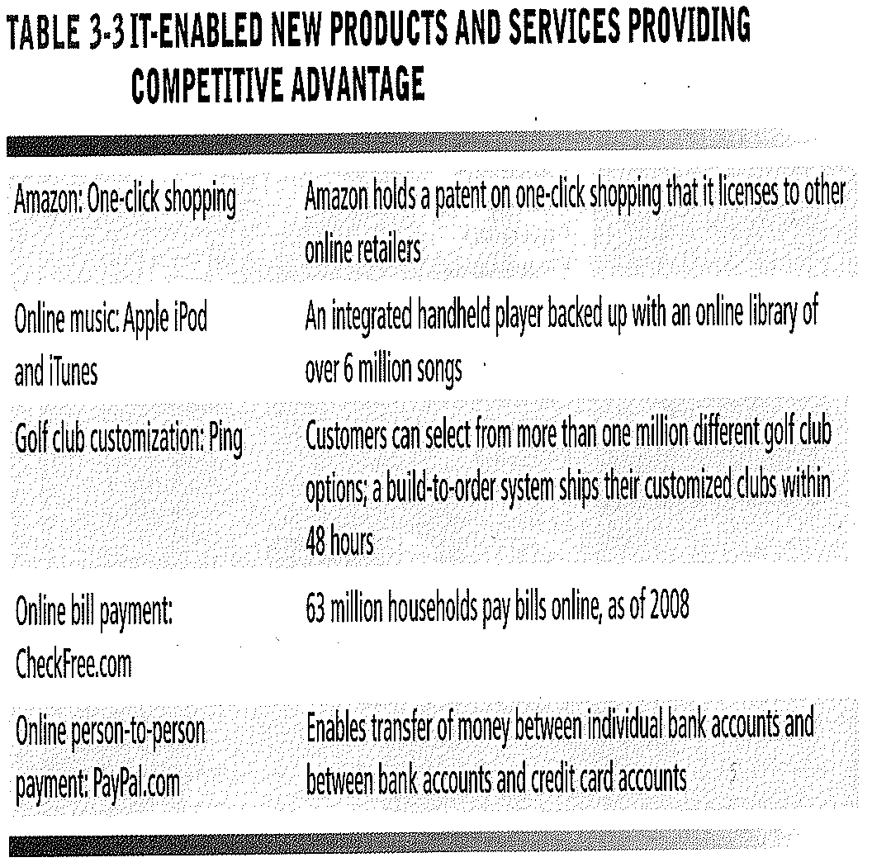
IT-Enabled New Products and Services Providing Competitive Advantage

Slide 39
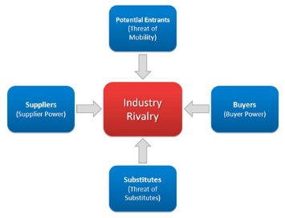
Strategies for dealing with competitive forces
3. Focus on market niche
Use information systems to enable a focused strategy on a single market niche; specialize
Example: Hilton Hotels
4. Strengthen customer and supplier intimacy
Use information systems to develop strong ties and loyalty with customers and suppliers; increase switching costs
Example: Chrysler, Amazon

Slide 40
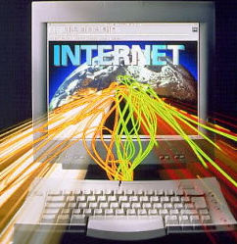
The Internet’s impact on competitive advantage
Transformation, destruction, threat to some industries
E.g. Travel agency, printed encyclopedia, newspaper
Competitive forces still at work, but rivalry more intense
Universal standards allow new rivals, entrants to market
New opportunities for building brands and loyal customer bases

Slide 41
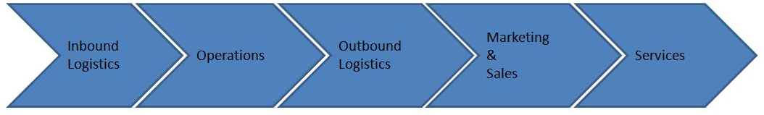
Value Chain
The value chain model highlights specific activities where competitive strategies can be applied and where information Systems are most likely to have a stragic impact.
The more value an organisation creates, the more profitable it is likely to be. And when you provide more value to your customers, you build competitive advantage.
Understanding how your company creates value, and looking for ways to add more value, are critical elements in developing a competitive strategy. At each stage, determine how information systems can improve operational efficiency and improve customer and supplier intimacy
Porter proposed a general-purpose value chain that companies can use to examine all of their activities, and see how they're connected. The way in which value chain activities are performed determines costs and affects profits, so this tool can help you understand the sources of value for your organisation.

Slide 42
Porter’s Value Chain
Firm Infrastructure (e.g. Finance, Planning)
Support
Activities
Human Resource Management
Technology Development
Procurement
Inbound
Logistics
Operations
(Manufacturing)
Outbound
Logistics
Marketing
and Sales
Margin
Primary
Activities
After-Sale
Service

Slide 43
Extending the Value Chain: The Value Web
More companies are incorporating the Internet in their business strategy. Ford Motor Company is forming many partnerships and alliances via their Web site to offer services and products that otherwise would be too difficult, costly, or time-consuming
The Ford Motor Company recognized that their value chain was linked to the value chains of its suppliers, distributors, and customers.
So quite simply it’s a collection of independent firms using highly synchronized IT to coordinate value chains to produce product or service collectively
Eg. TESCO & MUSGRAVES

Slide 44
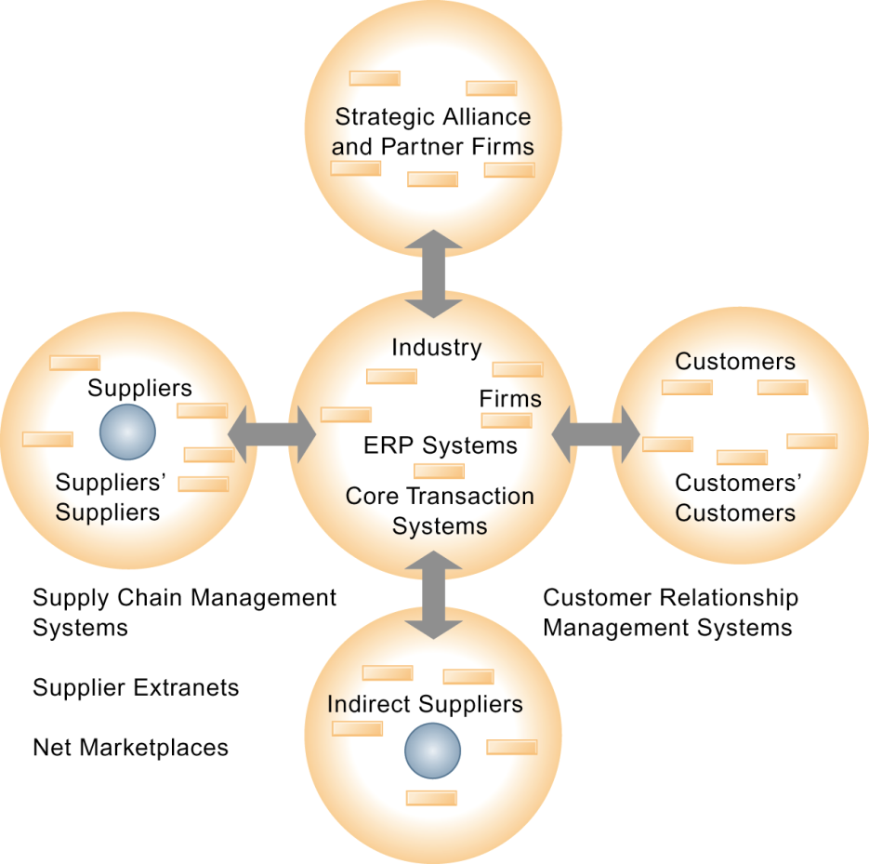
Value Web

Slide 45
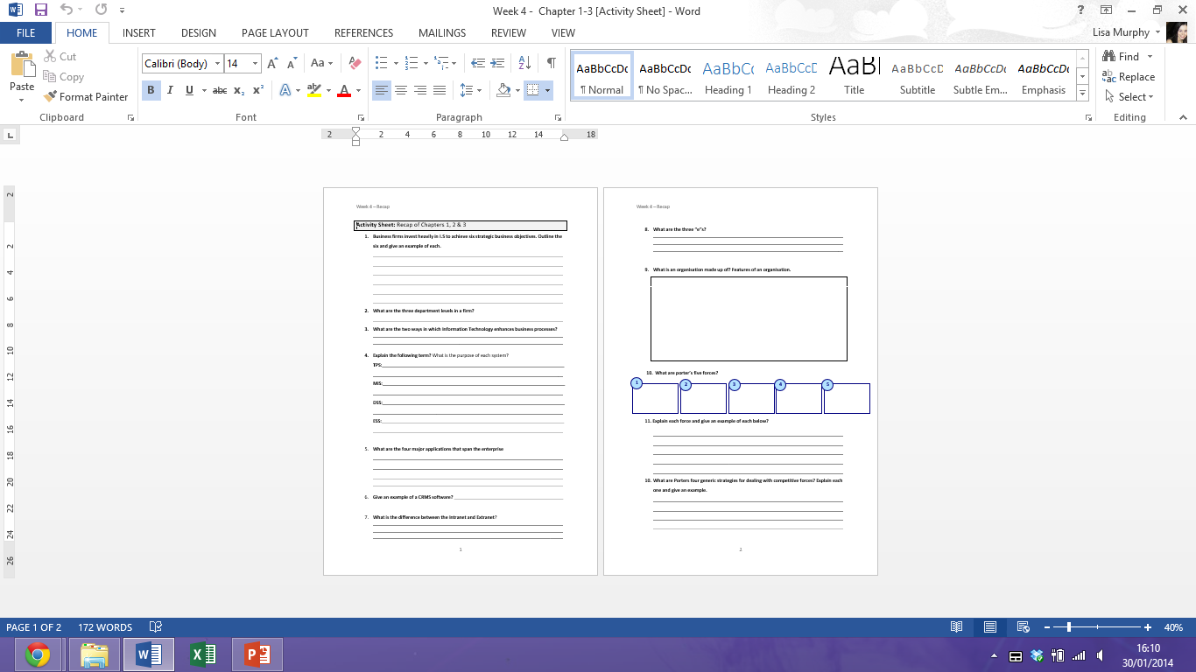
E xercise 1 – Activity Sheet

Slide 46

RECAP
To gain an understanding of the following:
Define and describe business processes and their relationship to information systems
Evaluate the role played by systems serving the various levels of management in a business and their relationship to each other
Explain how enterprise applications, collaboration and communication systems, and intranets improve organizational performance
Explain the difference between e-business, e-commerce, and e-government
Assess the role of the information systems function in a business

